Slide 1
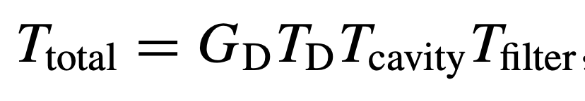
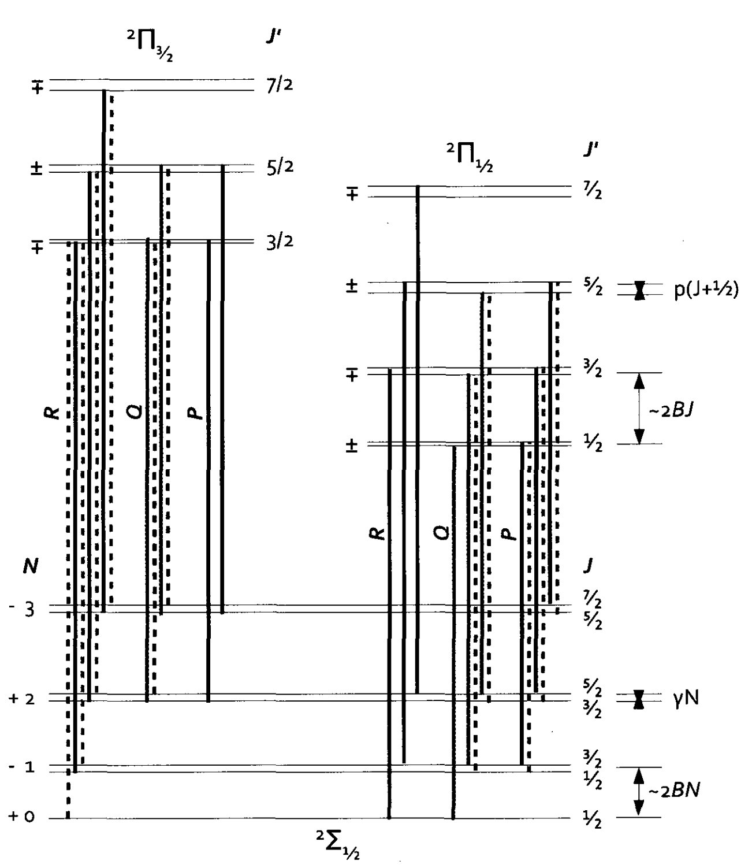
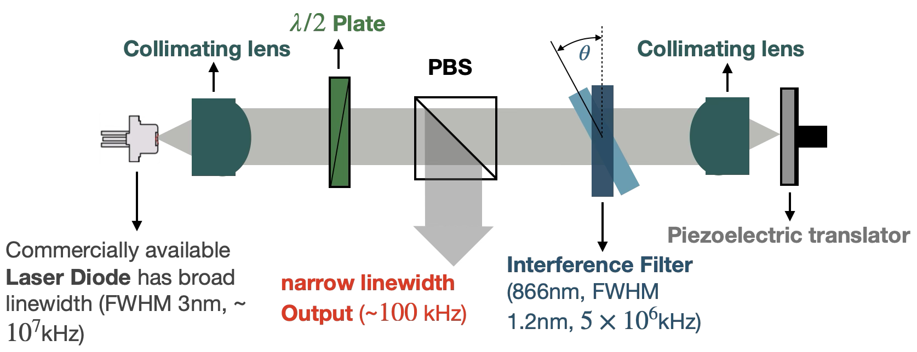
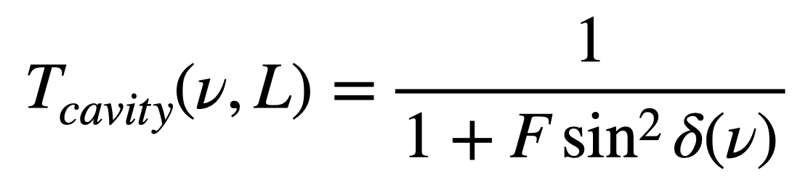
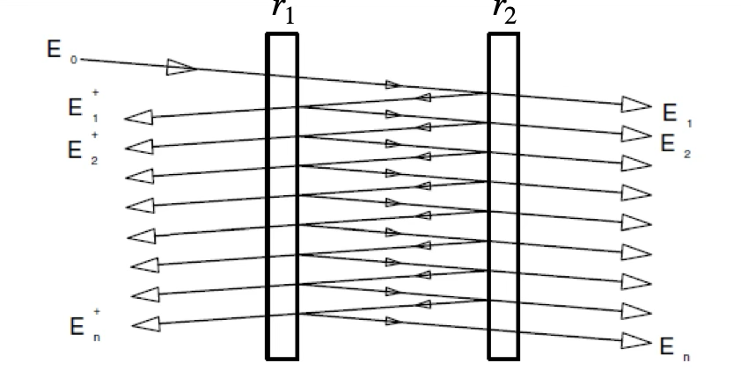
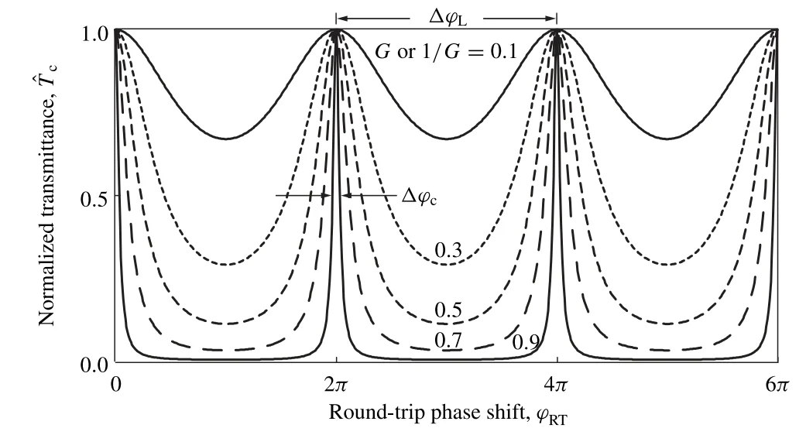
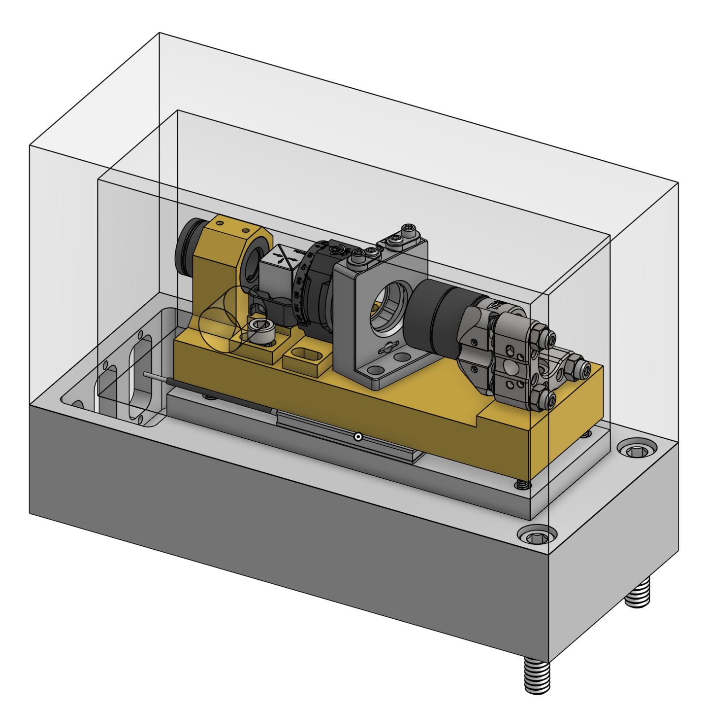
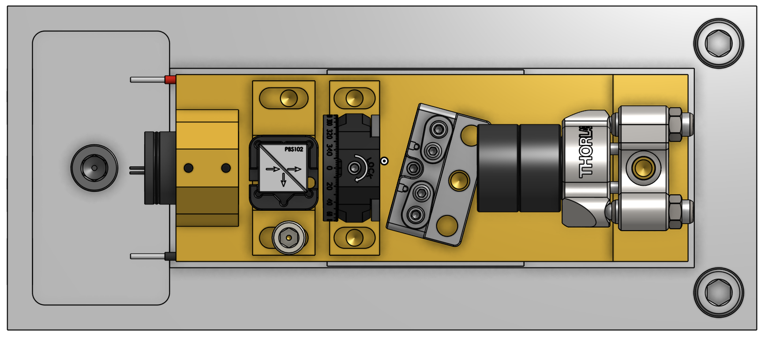
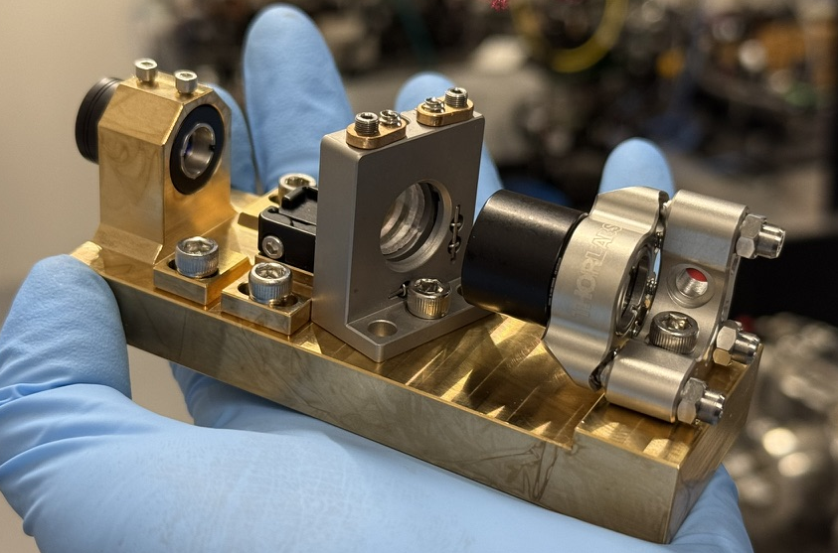
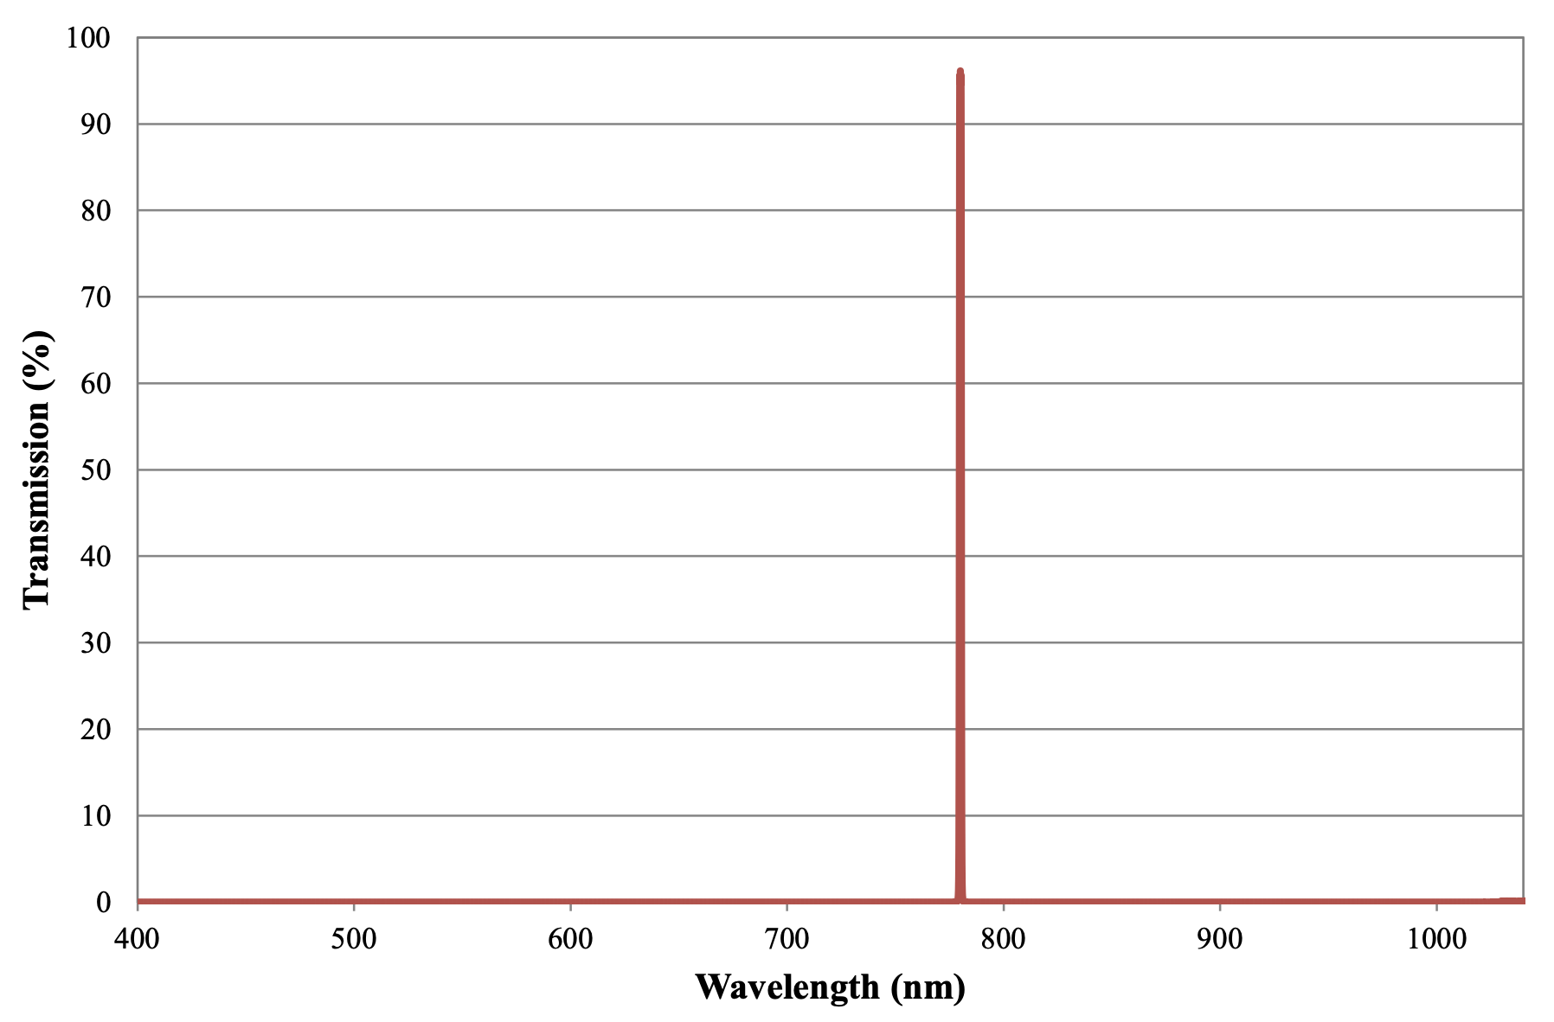

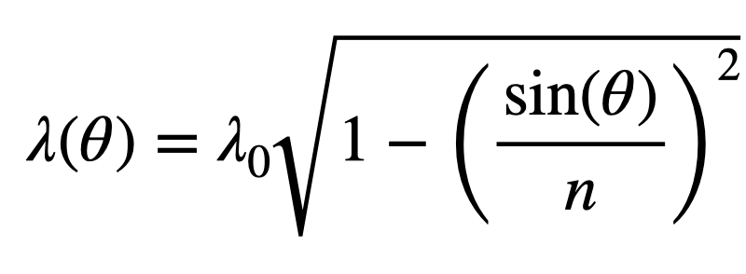
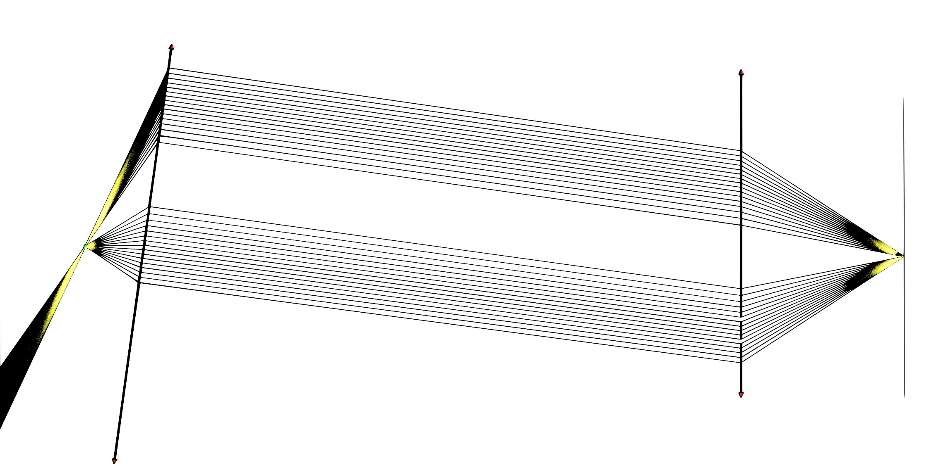
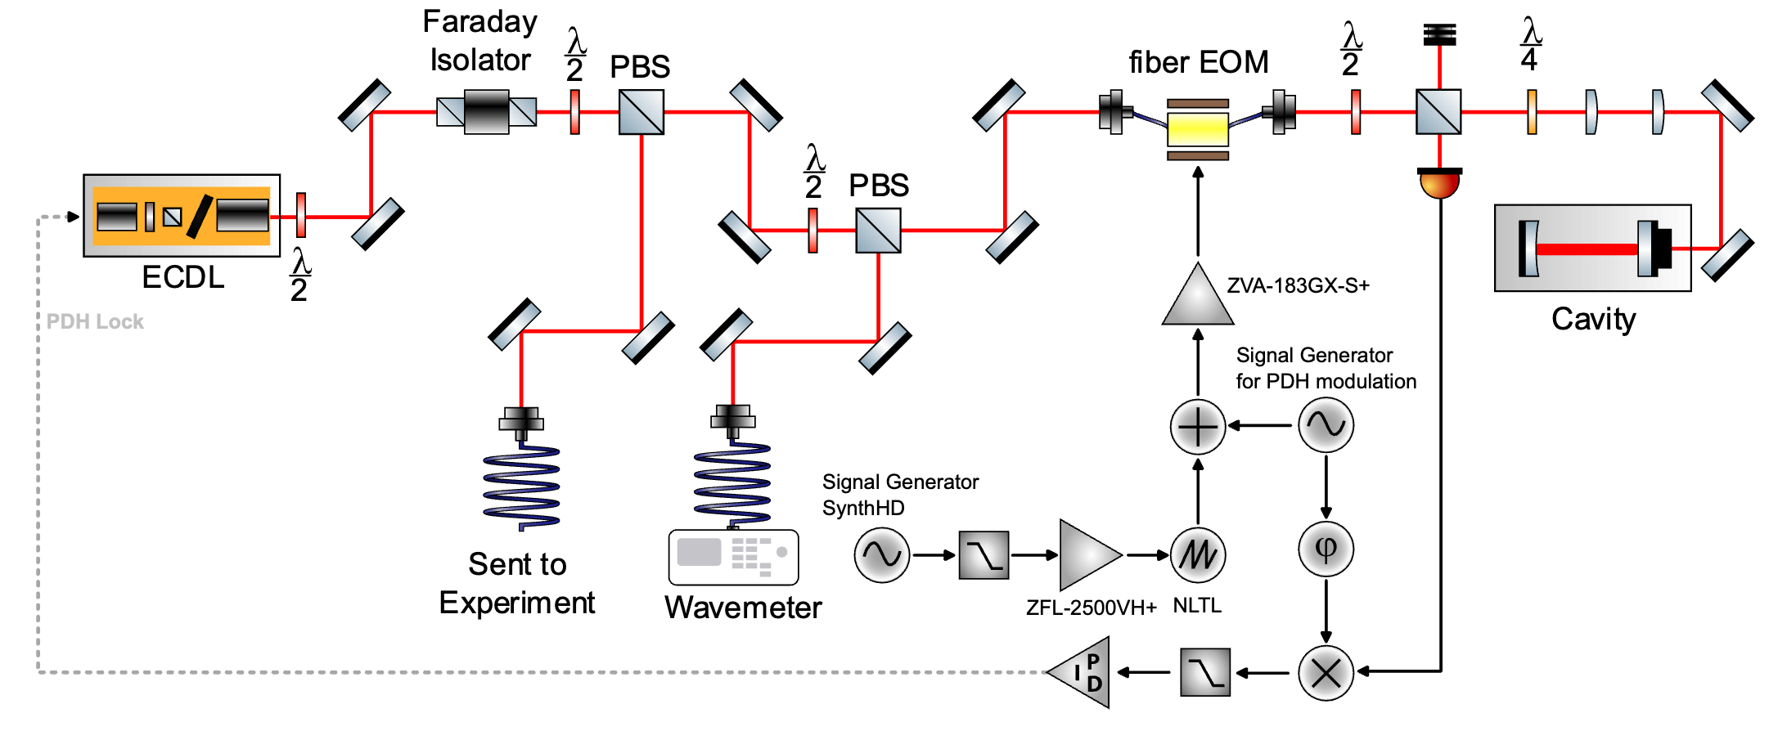
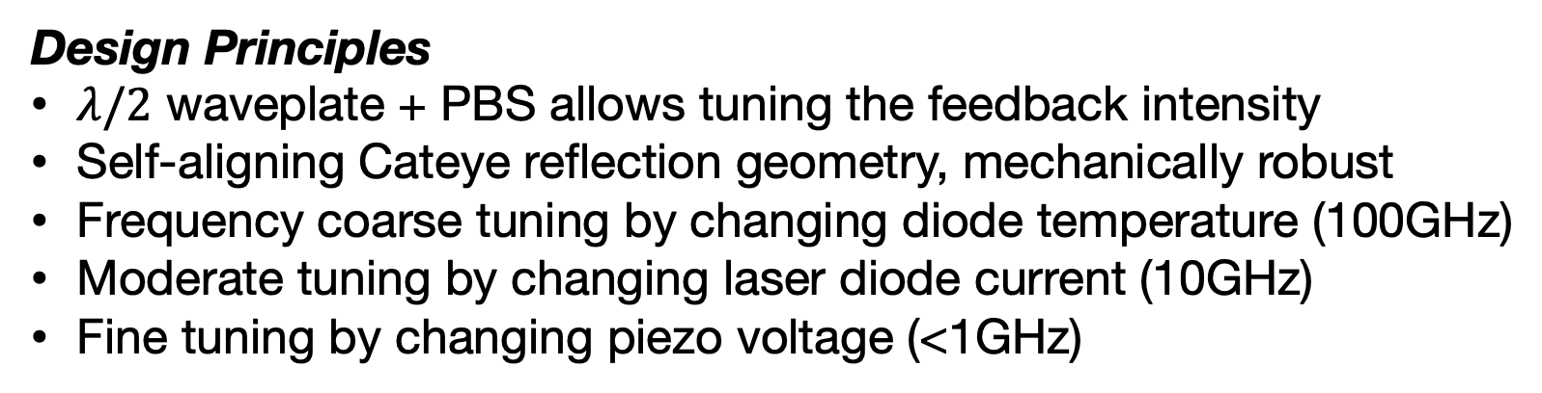
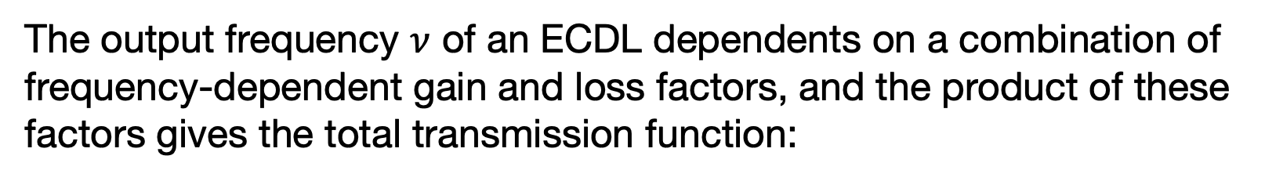
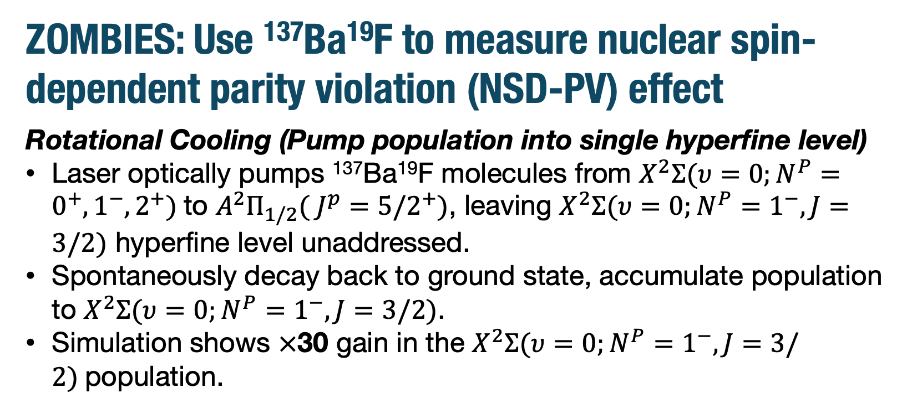
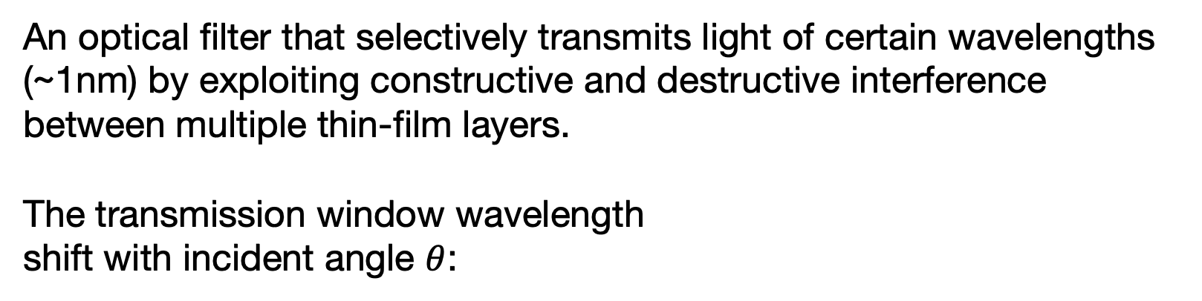
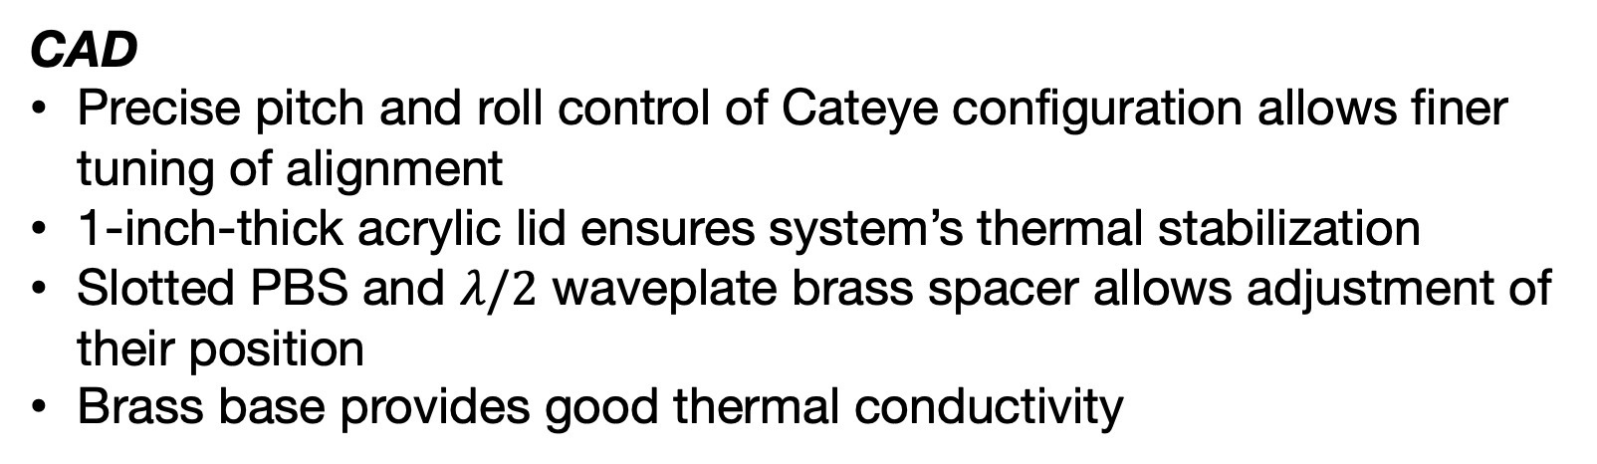
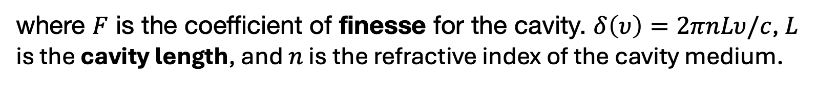
Interference Filter External Cavity Diode Laser (ECDL) with a Cateye Configuration
Robert Xi¹, Geoffrey Zheng¹, Mangesh Bhattarai ², David DeMille^{1, 2}
1. James Franck Institute and Department of Physics, University of Chicago, IL 60637
2. Physics Division, Argonne National Laboratory, Argonne IL 640439
Goals and Motivation
ZOMBIES: Use ¹³⁷Ba¹⁹F to measure nuclear spin-dependent parity violation (NSD-PV) effect
Rotational Cooling (Pump population into single hyperfine level)
Laser optically pumps ¹³⁷Ba¹⁹F molecules from $X^{2}Σ(υ=0;N^{P}=0^{+},1^{−},2^{+})$to $A^{2}Π_{1/2}( J^{p}={5/2}^{+})$, leaving $X^{2}Σ(υ=0;N^{P}=1^{−},J=3/2)$ hyperfine level unaddressed.
Spontaneously decay back to ground state, accumulate population to $X^{2}Σ(υ=0;N^{P}=1^{−},J=3/2)$.
Simulation shows $×$30 gain in the $X^{2}Σ(υ=0;N^{P}=1^{−},J=3/2)$population.
The laser will oscillate at the frequency for which the product of these factors is greatest.
Design
Laser Requirements
Narrow linewidth (~100 kHz)
Similar Level of precision would mean measuring earth-moon distance with an uncertainty of 1mm!
Wide tunability (~30GHz)
High stability.
Power output (~100mW)
Ease of use, small size, reproducible.
Design Principles
$λ/2$ waveplate + PBS allows tuning the feedback intensity
Self-aligning Cateye reflection geometry, mechanically robust
Frequency coarse tuning by changing diode temperature (100GHz)
Moderate tuning by changing laser diode current (10GHz)
Fine tuning by changing piezo voltage (<1GHz)
Theoretical Basis
Fabry-Perot Cavity
A Fabry–Perot cavity is an optical resonator consisting of two parallel, highly reflective mirrors that trap light through multiple reflections, creating standing waves at specific resonant frequencies.
CAD
Precise pitch and roll control of Cateye configuration allows finer tuning of alignment
1-inch-thick acrylic lid ensures system’s thermal stabilization
Slotted PBS and $λ/2$ waveplate brass spacer allows adjustment of their position
Brass base provides good thermal conductivity
where $F$ is the coefficient of finesse for the cavity. $δ\left(υ\right)=2πnLυ/c$, $L$ is the cavity length, and $n$ is the refractive index of the cavity medium.
Ultra-narrow Bandpass Interference Filter
An optical filter that selectively transmits light of certain wavelengths (~1nm) by exploiting constructive and destructive interference between multiple thin-film layers.
The transmission window wavelength
shift with incident angle $θ$:
Result
Diode Current Scan, Piezo Voltage Scan, and Feedforward
Without feedforward (scanning current and voltage simultaneously at correct ratio), scanning current gives discrete steps, scanning voltage gives ~1.5GHz MHFTR, consistent with simulation
With feedforward, MHFTR ~12GHz
Cateye Retroreflector
Consists of a lens-mirror combination (Cateye) and a lens-source pair aligned to face each other, with the mirror/light source positioned at the focal plane/point of the lens. This set up ensures any collimated beam from the lens-source pair is reflected back to the source, regardless of their relative angle (provided the beam strikes the Cateye).
Outlook
Advantages:
Easy to align
Mechanically stable
Transfer Cavity for frequency stabilization and frequency shifting laser
Laser Output Frequency
The output frequency $ν$ of an ECDL dependents on a combination of frequency-dependent gain and loss factors, and the product of these factors gives the total transmission function:

